Slide 1

Pennant Technologies Private Limited
Swings in Java

Slide 4
Collections in Java
The Collection in Java is a framework that provides an architecture to store and manipulate the group of objects.
Java Collections can achieve all the operations that you perform on a data such as searching, sorting, insertion, manipulation, and deletion.
Java Collection means a single unit of objects. Java Collection framework provides many interfaces (Set, List, Queue, Deque) and classes (ArrayList, Vector, LinkedList, PriorityQueue, HashSet, LinkedHashSet, TreeSet).
What is Collection in Java?
A Collection represents a single unit of objects, i.e., a group.
The Collection interface is the root interface of the collections framework hierarchy.
Java does not provide direct implementations of the Collection interface but provides implementations of its subinterfaces like List, Set, and Queue

Slide 5
What is a framework in Java
It provides readymade architecture.
It represents a set of classes and interfaces.
It is optional.
What is Collection framework
The Collection framework represents a unified architecture for storing and manipulating a group of objects. It has:
Interfaces and its implementations, i.e., classes
Algorithm
Interfaces of Collections FrameWork
The Java collections framework provides various interfaces. These interfaces include several methods to perform different operations on collections.
The Collection interface is the root interface of the collections framework. The framework includes other interfaces as well: Map and Iterator. These interfaces may also have subinterfaces.

Slide 6
Why Swings?
Swing in java is part of Java foundation class which is lightweight and platform independent.
It is used for creating window based applications.
It includes components like button, scroll bar, text field etc.
Putting together all these components makes a graphical user interface.
It is build on top of the AWT API and entirely written in java.
It is platform independent unlike AWT and has lightweight components.
It becomes easier to build applications since we already have GUI components like button, checkbox etc.
Unlike AWT, Java Swing provides platform-independent and lightweight components.
The javax.swing package provides classes for java swing API such as JButton, JTextField, JTextArea, JRadioButton, JCheckbox, JMenu, JColorChooser etc.

Slide 7
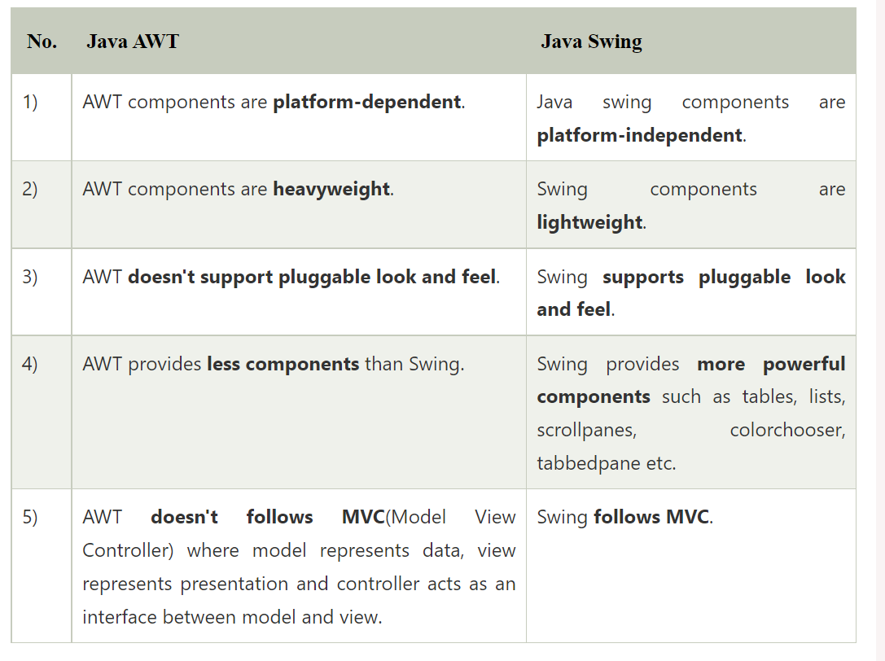
Difference between AWT and Swing

Slide 8
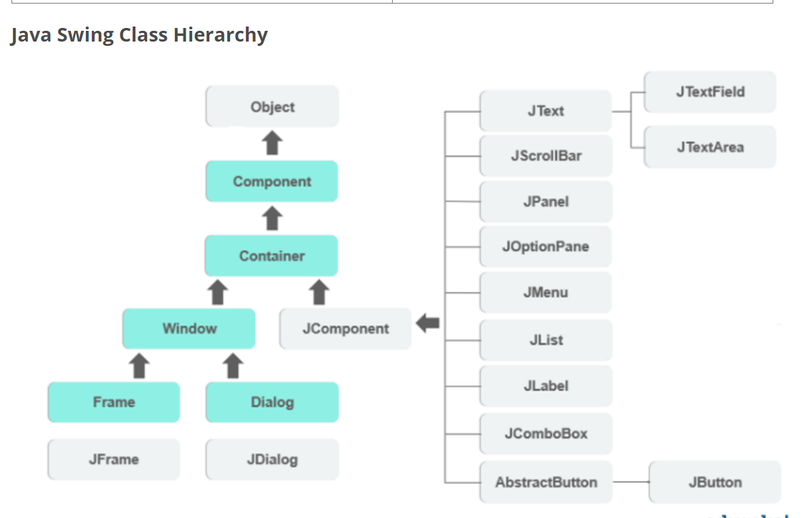

Slide 9
Container Class
Any class which has other components in it is called as a container class. For building GUI applications at least one container class is necessary.
Following are the three types of container classes:
Panel – It is used to organize components on to a window
Frame – A fully functioning window with icons and titles
Dialog – It is like a pop up window but not fully functional like the frame
Commonly used Methods of Component class
The methods of Component class are widely used in java swing that are given below.
Method Description
public void add(Component c) - add a component on another component.
public void setSize(int width,int height) -sets size of the component.
public void setLayout(LayoutManager m)- sets the layout manager for the component.
public void setVisible(boolean b)-sets the visibility of the component. It is by default false.

Slide 10
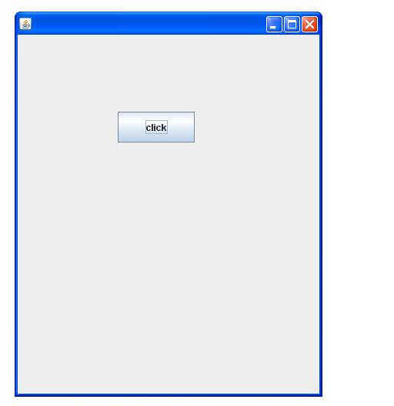
Java Swing Examples
There are two ways to create a frame:
By creating the object of Frame class (association)
By extending Frame class (inheritance)
Simple Java Swing Example
Let's see a simple swing example where we are creating one button and adding it on the JFrame object inside the main() method.
import javax.swing.*;
public class FirstSwingExample {
public static void main(String[] args) {
JFrame f=new JFrame();//creating instance of JFrame
JButton b=new JButton("click");//creating instance of JButton
b.setBounds(130,100,100, 40);//x axis, y axis, width, height
f.add(b);//adding button in JFrame
f.setSize(400,500);//400 width and 500 height
f.setLayout(null);//using no layout managers
f.setVisible(true);//making the frame visible } }

Slide 11
Example of Swing by Association inside constructor
We can also write all the codes of creating JFrame, JButton and method call inside the java constructor
File: Simple.java
import javax.swing.*;
public class Simple {
JFrame f;
Simple(){
f=new JFrame();//creating instance of JFrame
JButton b=new JButton("click");//creating instance of JButton
b.setBounds(130,100,100, 40);
f.add(b);//adding button in JFrame
f.setSize(400,500);//400 width and 500 height
f.setLayout(null);//using no layout managers
f.setVisible(true);//making the frame visible }
public static void main(String[] args) {
new Simple(); } }
The setBounds(int xaxis, int yaxis, int width, int height)is used in the above example that sets the position of the button.

Slide 12
Simple example of Swing by inheritance
We can also inherit the JFrame class, so there is no need to create the instance of JFrame class explicitly.
File: Simple2.jav
import javax.swing.*;
public class Simple2 extends JFrame{//inheriting JFrame
JFrame f;
Simple2(){
JButton b=new JButton("click");//create button
b.setBounds(130,100,100, 40);
add(b);//adding button on frame
setSize(400,500);
setLayout(null);
setVisible(true); }
public static void main(String[] args) {
new Simple2(); }}

Slide 13
Java JButton
The JButton class is used to create a labeled button that has platform independent implementation. The application result in some action when the button is pushed. It inherits AbstractButton class.
JButton class declaration
Let's see the declaration for javax.swing.JButton class.
public class JButton extends AbstractButton implements Accessible
Commonly used Constructors:
Constructor Description
JButton() It creates a button with no text and icon.
JButton(String s) It creates a button with the specified text.
JButton(Icon i) It creates a button with the specified icon object.
Commonly used Methods of AbstractButton class:
Methods Description
void setText(String s) It is used to set specified text on button
String getText() It is used to return the text of the button.
void setEnabled(boolean b) It is used to enable or disable the button.
void setIcon(Icon b) It is used to set the specified Icon on the button.
Icon getIcon() It is used to get the Icon of the button.
void setMnemonic(int a) It is used to set the mnemonic on the button.
void addActionListener(ActionListener a) It is used to add the action listener to this object.

Slide 14
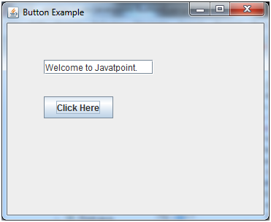
Java JButton Example with ActionListener
import java.awt.event.*;
import javax.swing.*;
public class ButtonExample {
public static void main(String[] args) {
JFrame f=new JFrame("Button Example");
final JTextField tf=new JTextField();
tf.setBounds(50,50, 150,20);
JButton b=new JButton("Click Here");
b.setBounds(50,100,95,30);
b.addActionListener(new ActionListener(){
public void actionPerformed(ActionEvent e){
tf.setText("Welcome to Javatpoint."); } });
f.add(b);f.add(tf);
f.setSize(400,400);
f.setLayout(null);
f.setVisible(true); } }

Slide 15
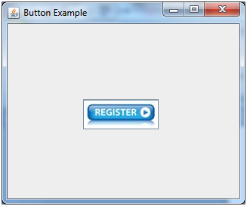
Example of displaying image on the button:
import javax.swing.*;
public class ButtonExample{
ButtonExample(){
JFrame f=new JFrame("Button Example");
JButton b=new JButton(new ImageIcon("D:\\icon.png"));
b.setBounds(100,100,100, 40);
f.add(b);
f.setSize(300,400);
f.setLayout(null);
f.setVisible(true);
f.setDefaultCloseOperation(JFrame.EXIT_ON_CLOSE); }
public static void main(String[] args) {
new ButtonExample(); } }

Slide 16
Java JLabel
The object of JLabel class is a component for placing text in a container. It is used to display a single line of read only text. The text can be changed by an application but a user cannot edit it directly. It inherits JComponent class. JLabel class declaration
Let's see the declaration for javax.swing.JLabel class.
public class JLabel extends JComponent implements SwingConstants, Accessible
Commonly used Constructors:
Constructor Description
JLabel() Creates a JLabel instance with no image and with an empty string for the title.
JLabel(String s) Creates a JLabel instance with the specified text.
JLabel(Icon i) Creates a JLabel instance with the specified image.
JLabel(String s, Icon i, int horizontalAlignment) Creates a JLabel instance with the specified text, image, and horizontal alignment.
Commonly used Methods:
Methods Description
String getText() t returns the text string that a label displays.
void setText(String text) It defines the single line of text this component will display.
void setHorizontalAlignment(int alignment) It sets the alignment of the label's contents along the X axis.
Icon getIcon() It returns the graphic image that the label displays.
int getHorizontalAlignment() It returns the alignment of the label's contents along the X axis.

Slide 17
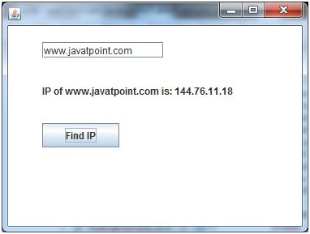
Java JLabel Example with ActionListener
import javax.swing.*;
import java.awt.*;
import java.awt.event.*;
public class LabelExample extends Frame implements ActionListener{
JTextField tf; JLabel l; JButton b;
LabelExample(){
tf=new JTextField();
tf.setBounds(50,50, 150,20);
l=new JLabel();
l.setBounds(50,100, 250,20);
b=new JButton("Find IP");
b.setBounds(50,150,95,30);
b.addActionListener(this);
add(b);add(tf);add(l);
setSize(400,400);
setLayout(null);
setVisible(true); }
public void actionPerformed(ActionEvent e) {
try{
String host=tf.getText();
String ip=java.net.InetAddress.getByName(host).getHostAddress();
l.setText("IP of "+host+" is: "+ip);
}catch(Exception ex){System.out.println(ex);} }
public static void main(String[] args) {
new LabelExample(); } }

Slide 18
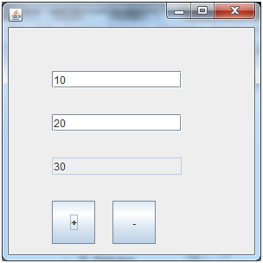
Java JTextField
import javax.swing.*; import java.awt.event.*;
public class TextFieldExample implements ActionListener{
JTextField tf1,tf2,tf3; JButton b1,b2; TextFieldExample(){ JFrame f= new JFrame();
tf1=new JTextField();
tf1.setBounds(50,50,150,20); tf2=new JTextField();
tf2.setBounds(50,100,150,20); tf3=new JTextField();
tf3.setBounds(50,150,150,20); tf3.setEditable(false);
b1=new JButton("+"); b1.setBounds(50,200,50,50);
b2=new JButton("-"); b2.setBounds(120,200,50,50);
b1.addActionListener(this); b2.addActionListener(this);
f.add(tf1);f.add(tf2);f.add(tf3);f.add(b1);f.add(b2);
f.setSize(300,300); f.setLayout(null); f.setVisible(true); }
public void actionPerformed(ActionEvent e) {
String s1=tf1.getText(); String s2=tf2.getText();
int a=Integer.parseInt(s1); int b=Integer.parseInt(s2);
int c=0;
if(e.getSource()==b1){
c=a+b;
}else if(e.getSource()==b2){
c=a-b; } String result=String.valueOf(c);
tf3.setText(result); }
public static void main(String[] args) {
new TextFieldExample(); } }

Slide 19
Java JTextArea
The object of a JTextArea class is a multi line region that displays text. It allows the editing of multiple line text. It inherits JTextComponent class
JTextArea class declaration
Let's see the declaration for javax.swing.JTextArea class.
public class JTextArea extends JTextComponent
Commonly used Constructors:
Constructor Description
JTextArea() Creates a text area that displays no text initially.
JTextArea(String s) Creates a text area that displays specified text initially.
JTextArea(int row, int column) Creates a text area with the specified number of rows and columns that displays no text initially.
JTextArea(String s, int row, int column) Creates a text area with the specified number of rows and columns that displays specified text.
Commonly used Methods:
Methods Description
void setRows(int rows) It is used to set specified number of rows.
void setColumns(int cols) It is used to set specified number of columns.
void setFont(Font f) It is used to set the specified font.
void insert(String s, int position) It is used to insert the specified text on the specified position.
void append(String s) It is used to append the given text to the end of the document.

Slide 20
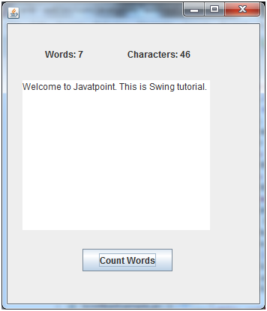
Java JTextArea Example with ActionListener
import javax.swing.*; import java.awt.event.*;
public class TextAreaExample implements ActionListener{
JLabel l1,l2; JTextArea area; JButton b;
TextAreaExample() {
JFrame f= new JFrame();
l1=new JLabel(); l1.setBounds(50,25,100,30);
l2=new JLabel(); l2.setBounds(160,25,100,30);
area=new JTextArea(); area.setBounds(20,75,250,200);
b=new JButton("Count Words"); b.setBounds(100,300,120,30);
b.addActionListener(this);
f.add(l1);f.add(l2);f.add(area);f.add(b);
f.setSize(450,450);
f.setLayout(null);
f.setVisible(true); }
public void actionPerformed(ActionEvent e){
String text=area.getText();
String words[]=text.split("\\s");
l1.setText("Words: "+words.length);
l2.setText("Characters: "+text.length()); }
public static void main(String[] args) {
new TextAreaExample(); } }

Slide 21
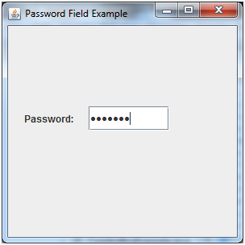
Java JPasswordField
The object of a JPasswordField class is a text component specialized for password entry. It allows the editing of a single line of text. It inherits JTextField class.
JPasswordField class declaration
Let's see the declaration for javax.swing.JPasswordField class.
public class JPasswordField extends JTextField
Commonly used Constructors:
Constructor Description
JPasswordField() - Constructs a new JPasswordField, with a default document, null starting text string, and 0 column width.
JPasswordField(int columns) - Constructs a new empty JPasswordField with the specified number of columns.
JPasswordField(String text) - Constructs a new JPasswordField initialized with the specified text.
JPasswordField(String text, int columns) - Construct a new JPasswordField initialized with the specified text and columns.
import javax.swing.*;
public class PasswordFieldExample {
public static void main(String[] args) {
JFrame f=new JFrame("Password Field Example");
JPasswordField value = new JPasswordField();
JLabel l1=new JLabel("Password:");
l1.setBounds(20,100, 80,30);
value.setBounds(100,100,100,30);
f.add(value); f.add(l1);
f.setSize(300,300);
f.setLayout(null);
f.setVisible(true); } }

Slide 22
Java JCheckBox
The JCheckBox class is used to create a checkbox. It is used to turn an option on (true) or off (false). Clicking on a CheckBox changes its state from "on" to "off" or from "off" to "on ".It inherits JToggleButton class.
JCheckBox class declaration
Let's see the declaration for javax.swing.JCheckBox class.
public class JCheckBox extends JToggleButton implements Accessible
Commonly used Constructors:
Constructor Description
JJCheckBox() Creates an initially unselected check box button with no text, no icon.
JChechBox(String s) Creates an initially unselected check box with text.
JCheckBox(String text, boolean selected) Creates a check box with text and specifies whether or not it is initially selected.
JCheckBox(Action a) Creates a check box where properties are taken from the Action supplied.
Commonly used Methods:
Methods Description
AccessibleContext getAccessibleContext() It is used to get the AccessibleContext associated with this JCheckBox.
protected String paramString() It returns a string representation of this JCheckBox.

Slide 23
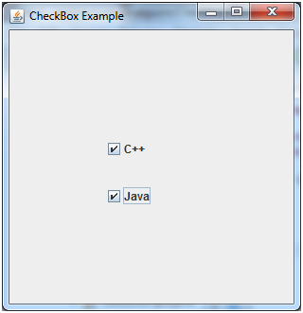
Java JCheckBox Example
import javax.swing.*;
public class CheckBoxExample {
CheckBoxExample(){
JFrame f= new JFrame("CheckBox Example");
JCheckBox checkBox1 = new JCheckBox("C++");
checkBox1.setBounds(100,100, 50,50);
JCheckBox checkBox2 = new JCheckBox("Java", true);
checkBox2.setBounds(100,150, 50,50);
f.add(checkBox1);
f.add(checkBox2);
f.setSize(400,400);
f.setLayout(null);
f.setVisible(true); }
public static void main(String args[]) {
new CheckBoxExample(); }}

Slide 24
Java JRadioButton
The JRadioButton class is used to create a radio button. It is used to choose one option from multiple options. It is widely used in exam systems or quiz.
It should be added in ButtonGroup to select one radio button only.
JRadioButton class declaration
Let's see the declaration for javax.swing.JRadioButton class.
public class JRadioButton extends JToggleButton implements Accessible
Commonly used Constructors:
Constructor Description
JRadioButton() Creates an unselected radio button with no text.
JRadioButton(String s) Creates an unselected radio button with specified text.
JRadioButton(String s, boolean selected) Creates a radio button with the specified text and selected status.
Commonly used Methods:
Methods Description
void setText(String s) It is used to set specified text on button.
String getText() It is used to return the text of the button.
void setEnabled(boolean b) It is used to enable or disable the button.
void setIcon(Icon b) It is used to set the specified Icon on the button.
Icon getIcon() It is used to get the Icon of the button.
void setMnemonic(int a) It is used to set the mnemonic on the button.
void addActionListener(ActionListener a) It is used to add the action listener to this object.

Slide 25
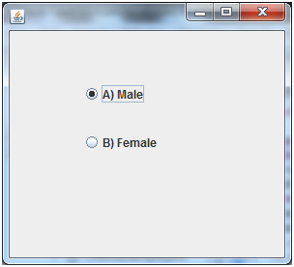
Java JRadioButton Example
import javax.swing.*;
public class RadioButtonExample {
JFrame f;
RadioButtonExample(){
f=new JFrame();
JRadioButton r1=new JRadioButton("A) Male");
JRadioButton r2=new JRadioButton("B) Female");
r1.setBounds(75,50,100,30);
r2.setBounds(75,100,100,30);
ButtonGroup bg=new ButtonGroup();
bg.add(r1);bg.add(r2);
f.add(r1);f.add(r2);
f.setSize(300,300);
f.setLayout(null); f.setVisible(true); }
public static void main(String[] args) {
new RadioButtonExample(); } }

Slide 26
Java JComboBox
The object of Choice class is used to show popup menu of choices. Choice selected by user is shown on the top of a menu. It inherits JComponent class.
JComboBox class declaration
Let's see the declaration for javax.swing.JComboBox class.
public class JComboBox extends JComponent implements ItemSelectable, ListDataListener, ActionListener, Accessible
Commonly used Constructors:
Constructor Description
JComboBox() Creates a JComboBox with a default data model.
JComboBox(Object[] items) Creates a JComboBox that contains the elements in the specified array.
JComboBox(Vector<?> items) Creates a JComboBox that contains the elements in the specified Vector.
Commonly used Methods:
Methods Description
void addItem(Object anObject) It is used to add an item to the item list.
void removeItem(Object anObject) It is used to delete an item to the item list.
void removeAllItems() It is used to remove all the items from the list.
void setEditable(boolean b) It is used to determine whether the JComboBox is editable.
void addActionListener(ActionListener a) It is used to add the ActionListener.
void addItemListener(ItemListener i) It is used to add the ItemListener.

Slide 27
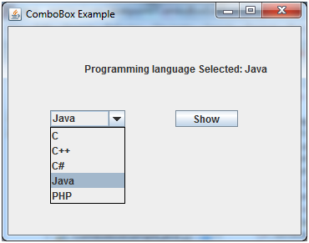
Java JComboBox Example with ActionListener
import javax.swing.*;
import java.awt.event.*;
public class ComboBoxExample {
JFrame f;
ComboBoxExample(){
f=new JFrame("ComboBox Example");
final JLabel label = new JLabel();
label.setHorizontalAlignment(JLabel.CENTER); label.setSize(400,100);
JButton b=new JButton("Show"); b.setBounds(200,100,75,20);
String languages[]={"C","C++","C#","Java","PHP"};
final JComboBox cb=new JComboBox(languages);
cb.setBounds(50, 100,90,20);
f.add(cb); f.add(label); f.add(b);
f.setLayout(null); f.setSize(350,350); f.setVisible(true);
b.addActionListener(new ActionListener() {
public void actionPerformed(ActionEvent e) {
String data = "Programming language Selected: "
+ cb.getItemAt(cb.getSelectedIndex());
label.setText(data); } }); }
public static void main(String[] args) {
new ComboBoxExample(); } }

Slide 28
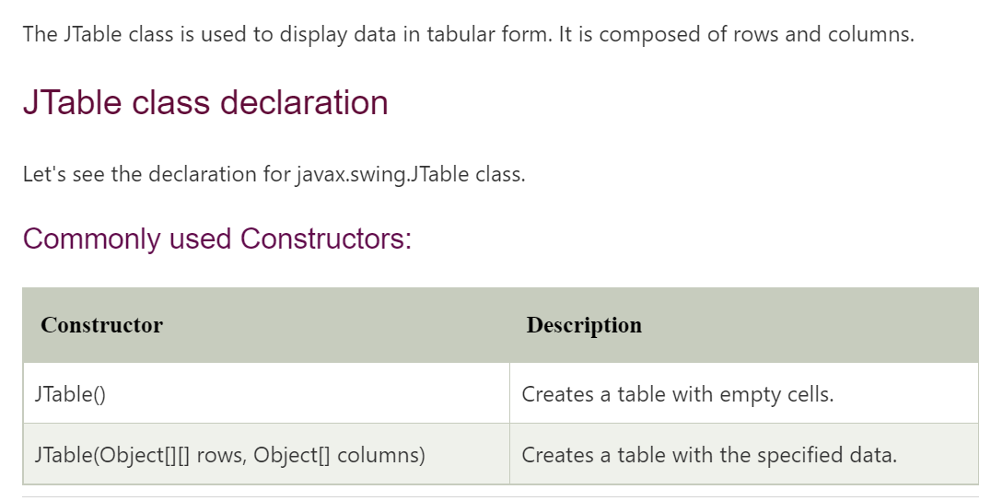
JTABLE

Slide 29
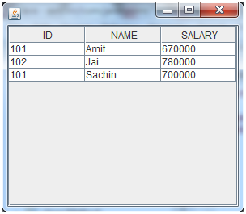
Java JTable Example
import javax.swing.*;
public class TableExample {
JFrame f;
TableExample(){
f=new JFrame();
String data[][]={ {"101","Amit","670000"},
{"102","Jai","780000"},
{"101","Sachin","700000"}};
String column[]={"ID","NAME","SALARY"};
JTable jt=new JTable(data,column);
jt.setBounds(30,40,200,300);
JScrollPane sp=new JScrollPane(jt);
f.add(sp);
f.setSize(300,400);
f.setVisible(true); }
public static void main(String[] args) {
new TableExample(); } }

